Slide 1
Congressional
Tweets

Slide 2
Proposal
Client:
Helping Lobbyists4America understand relationships between congress members better through their tweets.
Using this intel to help them better target their clients’ lobbying efforts in Congress.
Hypotheses:
There will be clusters of like-minded politicians that can be drawn largely along party lines.
There will be centres of influence (loud / influential voices) in these clusters that clients can target.
Some themes will emerge as more topical in this time period
Approach:
Exploratory analysis on over 1m tweets from members of Congress that has been collected.
Use a Bag-of-Words approach to understand the main themes in this time period
Focus on the main themes, scoring active members’ tweets on their sentiment on these issues.
Find correlations between members, and identify clusters of like-minded members.

Slide 3
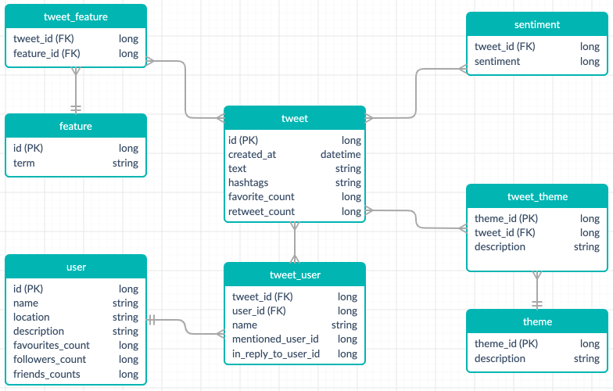
The Data
Entity-Relationship Diagram showing the data available to us and it’s connections

Slide 4
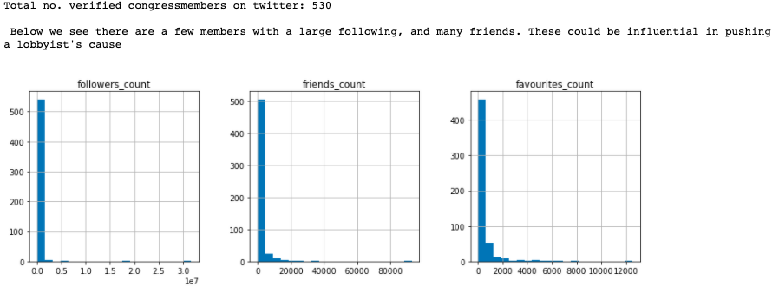
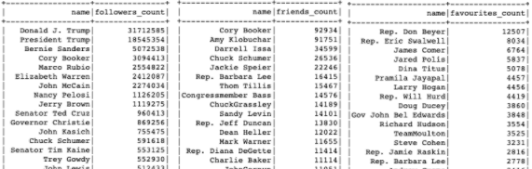
Exploratory Data Analysis: Members

Slide 5
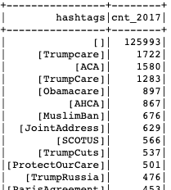
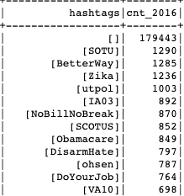
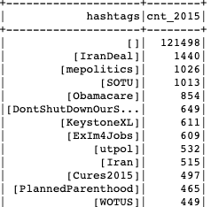
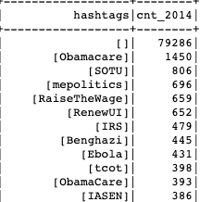
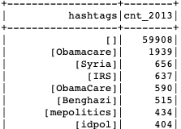
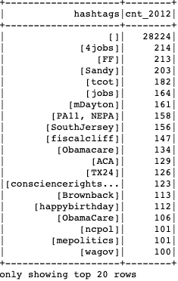
Exploratory Data Analysis: Themes
Looking at hashtags we can see which themes were popular across the years when Twitter usage was relevant thing among members (2012 and later).

Slide 6
Exploratory Data Analysis: Initial Findings
Twitter usage increased to become something we can use for analysis after 2012, themes before this therefore won’t be looked at as meaningful indicators of member relationships.
There were very few members with a large following and friend count, these would be a major scalp for lobbyists if they were able to come round to agreement with industry ideas.
ACA / Obamacare was by far the biggest issue across several years of the data, judging from hashtags although most tweets didn’t carry any hashtags
Members who called it ACA tended to support it, those who called it Obamacare tended to oppose it.

Slide 7
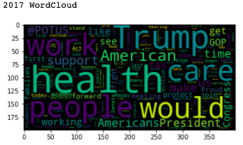
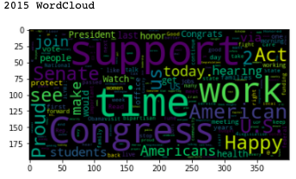
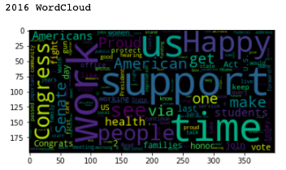
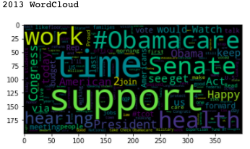
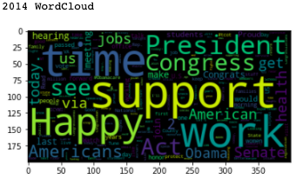
Finding the main themes: Bag of Words
After removing ‘stop-words’ we found the words that appeared most in tweets across different years, the word clouds below show the most popular words: confirming Healthcare (esp. 2013/14)

Slide 8
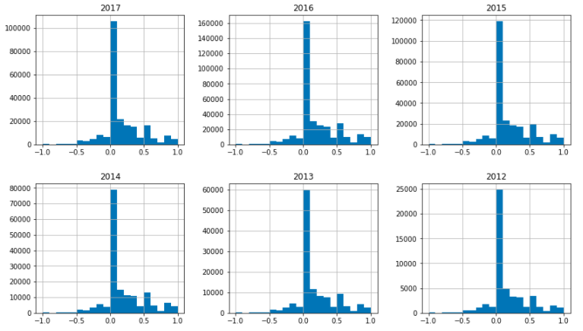
Sentiment Analysis: An Initial Look
We used a package called Textblob to score sentiment of each tweet, we were then able to find a distribution for sentiment which, regardless of year looked very similarly distributed, and were more positive than negative.

Slide 9
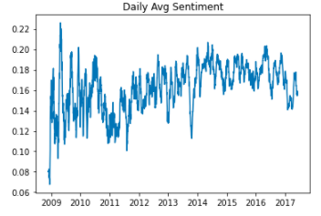
Sentiment Analysis: An Initial Look
I found that both at the overall level, and when drilling down by year, or by themes: the sentiment volatility was inversely correlated to the number of tweets. In any slice of the data, the more tweets we had, the less erratic were the spikes in sentiment, particularly on a moving average basis.

Slide 10
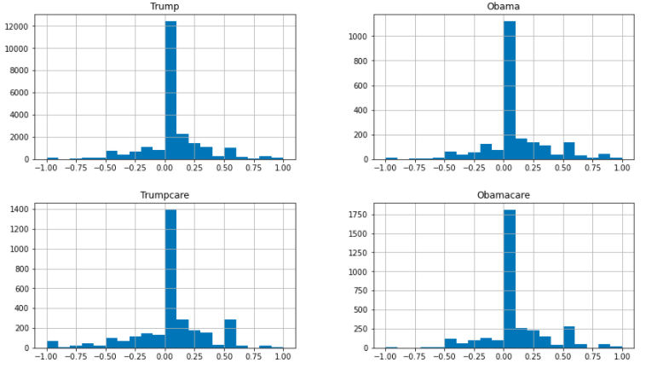
Sentiment Analysis: Theme-specific
Looking at distribution of sentiment for some of the main themes:
2017: Trump vs Obama distribution very similar, however Trumpcare received more negative tweets than did Obamacare. Beyond this, difficult to make much useful inference at this high level.

Slide 11
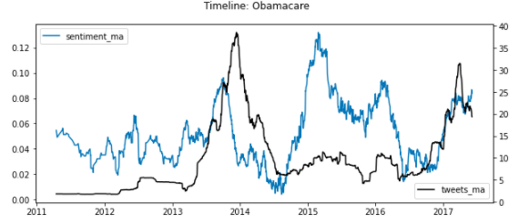
Sentiment Analysis: Theme-specific trends
The trend (90 day moving average) in number and sentiment in Obamacare related tweets fluctuated. A 2013/14 increase in tweets with Obamacare in the text saw a fall in sentiment, likely due to this term for the ACA largely being a Republican tactic.

Slide 12
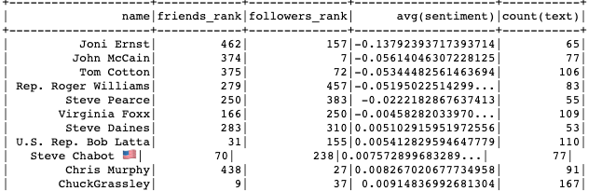
Sentiment Analysis: Theme-specific trends
The most negative Obamacare tweeters were largely Republicans, and the most positive were largely Democrats. I show the most negative tweeters here based on the average sentiment of all their Obamacare tweets, and only if they have tweeted 50 or more times re: Obamacare. I also included where they ranked among their peers in terms of how many followers / friends to gauge influence. For example, John McCain was 7th highest in terms of no. of followers across all members, which made his 77 Obamacare tweets reach a wider audience.

Slide 13
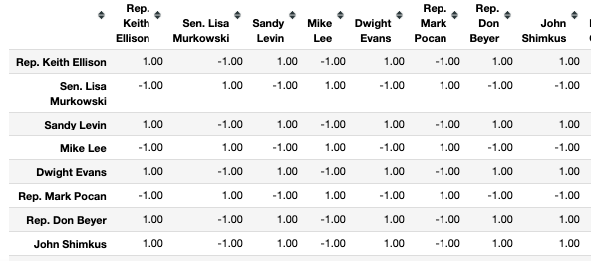
New metrics: correlation between members
Spearman Rank Correlation: I wanted to see if there’s a correlation between members in their view across different themes. Here I did a simple case study for their views on Trumpcare and Obamacare tweets, there was good agreement with political affiliation, however I need to get more nuanced clustering than just 1 or -1 correlations.

Slide 14
New metrics: clusters
Clustering: Spark’s Bisecting K-Means clustering algorithm was used, using silhouette score to optimise for the number of clusters (k=6). Members clustered based on their sentiment in ACA and in Obamacare related tweets, and also the number of times they tweeted about these topics. I wanted to show polarity of view and also strength of feeling, and also created more nuanced clustering than just party affiliation.
Some findings:
It was interesting to see that the clusters appeared to make sense, and I was able to find this more nuanced dissection of members on the issue of Healthcare.
Some clusters held positive / vociferous, some moderate / quiet, others moderate / vociferous.
It was interesting to also see the correlation appear again between num_tweets and sentiment_polarity. The more someone tweeted on the issue, then the average sentiment tended to be more moderate.
I also added that congress member’s overall ranking in terms of follower count, to the chart annotations which helps us understand centres of influence in the clusters. We can see for example that Cory Booker and Bernie Sanders are influential within their respective clusters

Slide 15
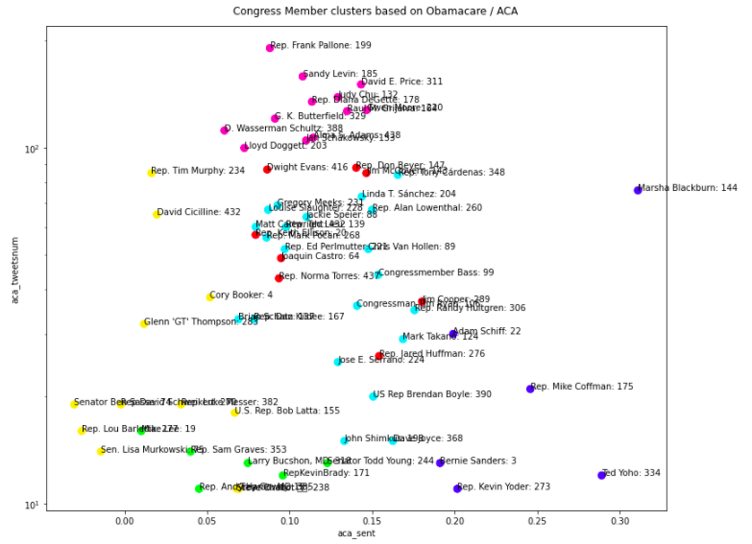

Slide 16
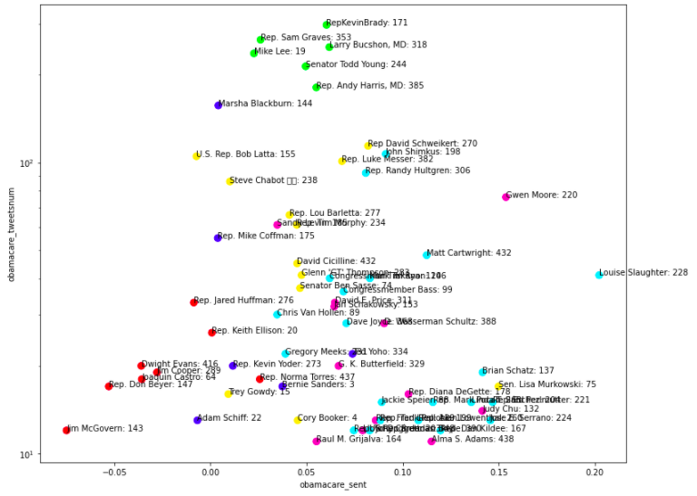

Slide 17
Hypothesis Conclusions
There will be clusters of like-minded politicians that can be drawn largely along party lines.
Proved: This was clear to see from those who referred to healthcare reforms as ACA vs those who called it Obamacare. Also clear to see from the clusters that emerged.
There will be centres of influence (loud / influential voices) in these clusters that clients can target.
Proved: For example Cory Booker and Bernie Sanders were the members with the highest number of followers within their respective clusters.
For clients that want to influence this section of members, these influential Senators would be the highest value advocates of their messaging.
For clients who opposed ACA then members like Mike Lee could serve as a powerful voice.
Some themes will emerge as more topical in this time periods
Proved: We found Healthcare was most important issue in this period.

